Slide 1
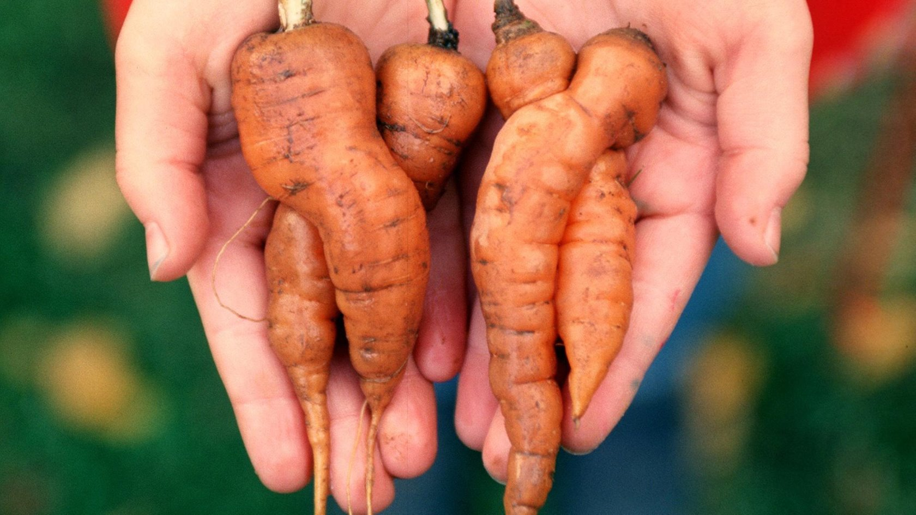

Group 6 : Urban Agriculture and Circular Food Systems
Free the Carrots
Anja Ehninger, Egzon Osmani, Sandra Stern, Isabelle Wippl

Slide 2
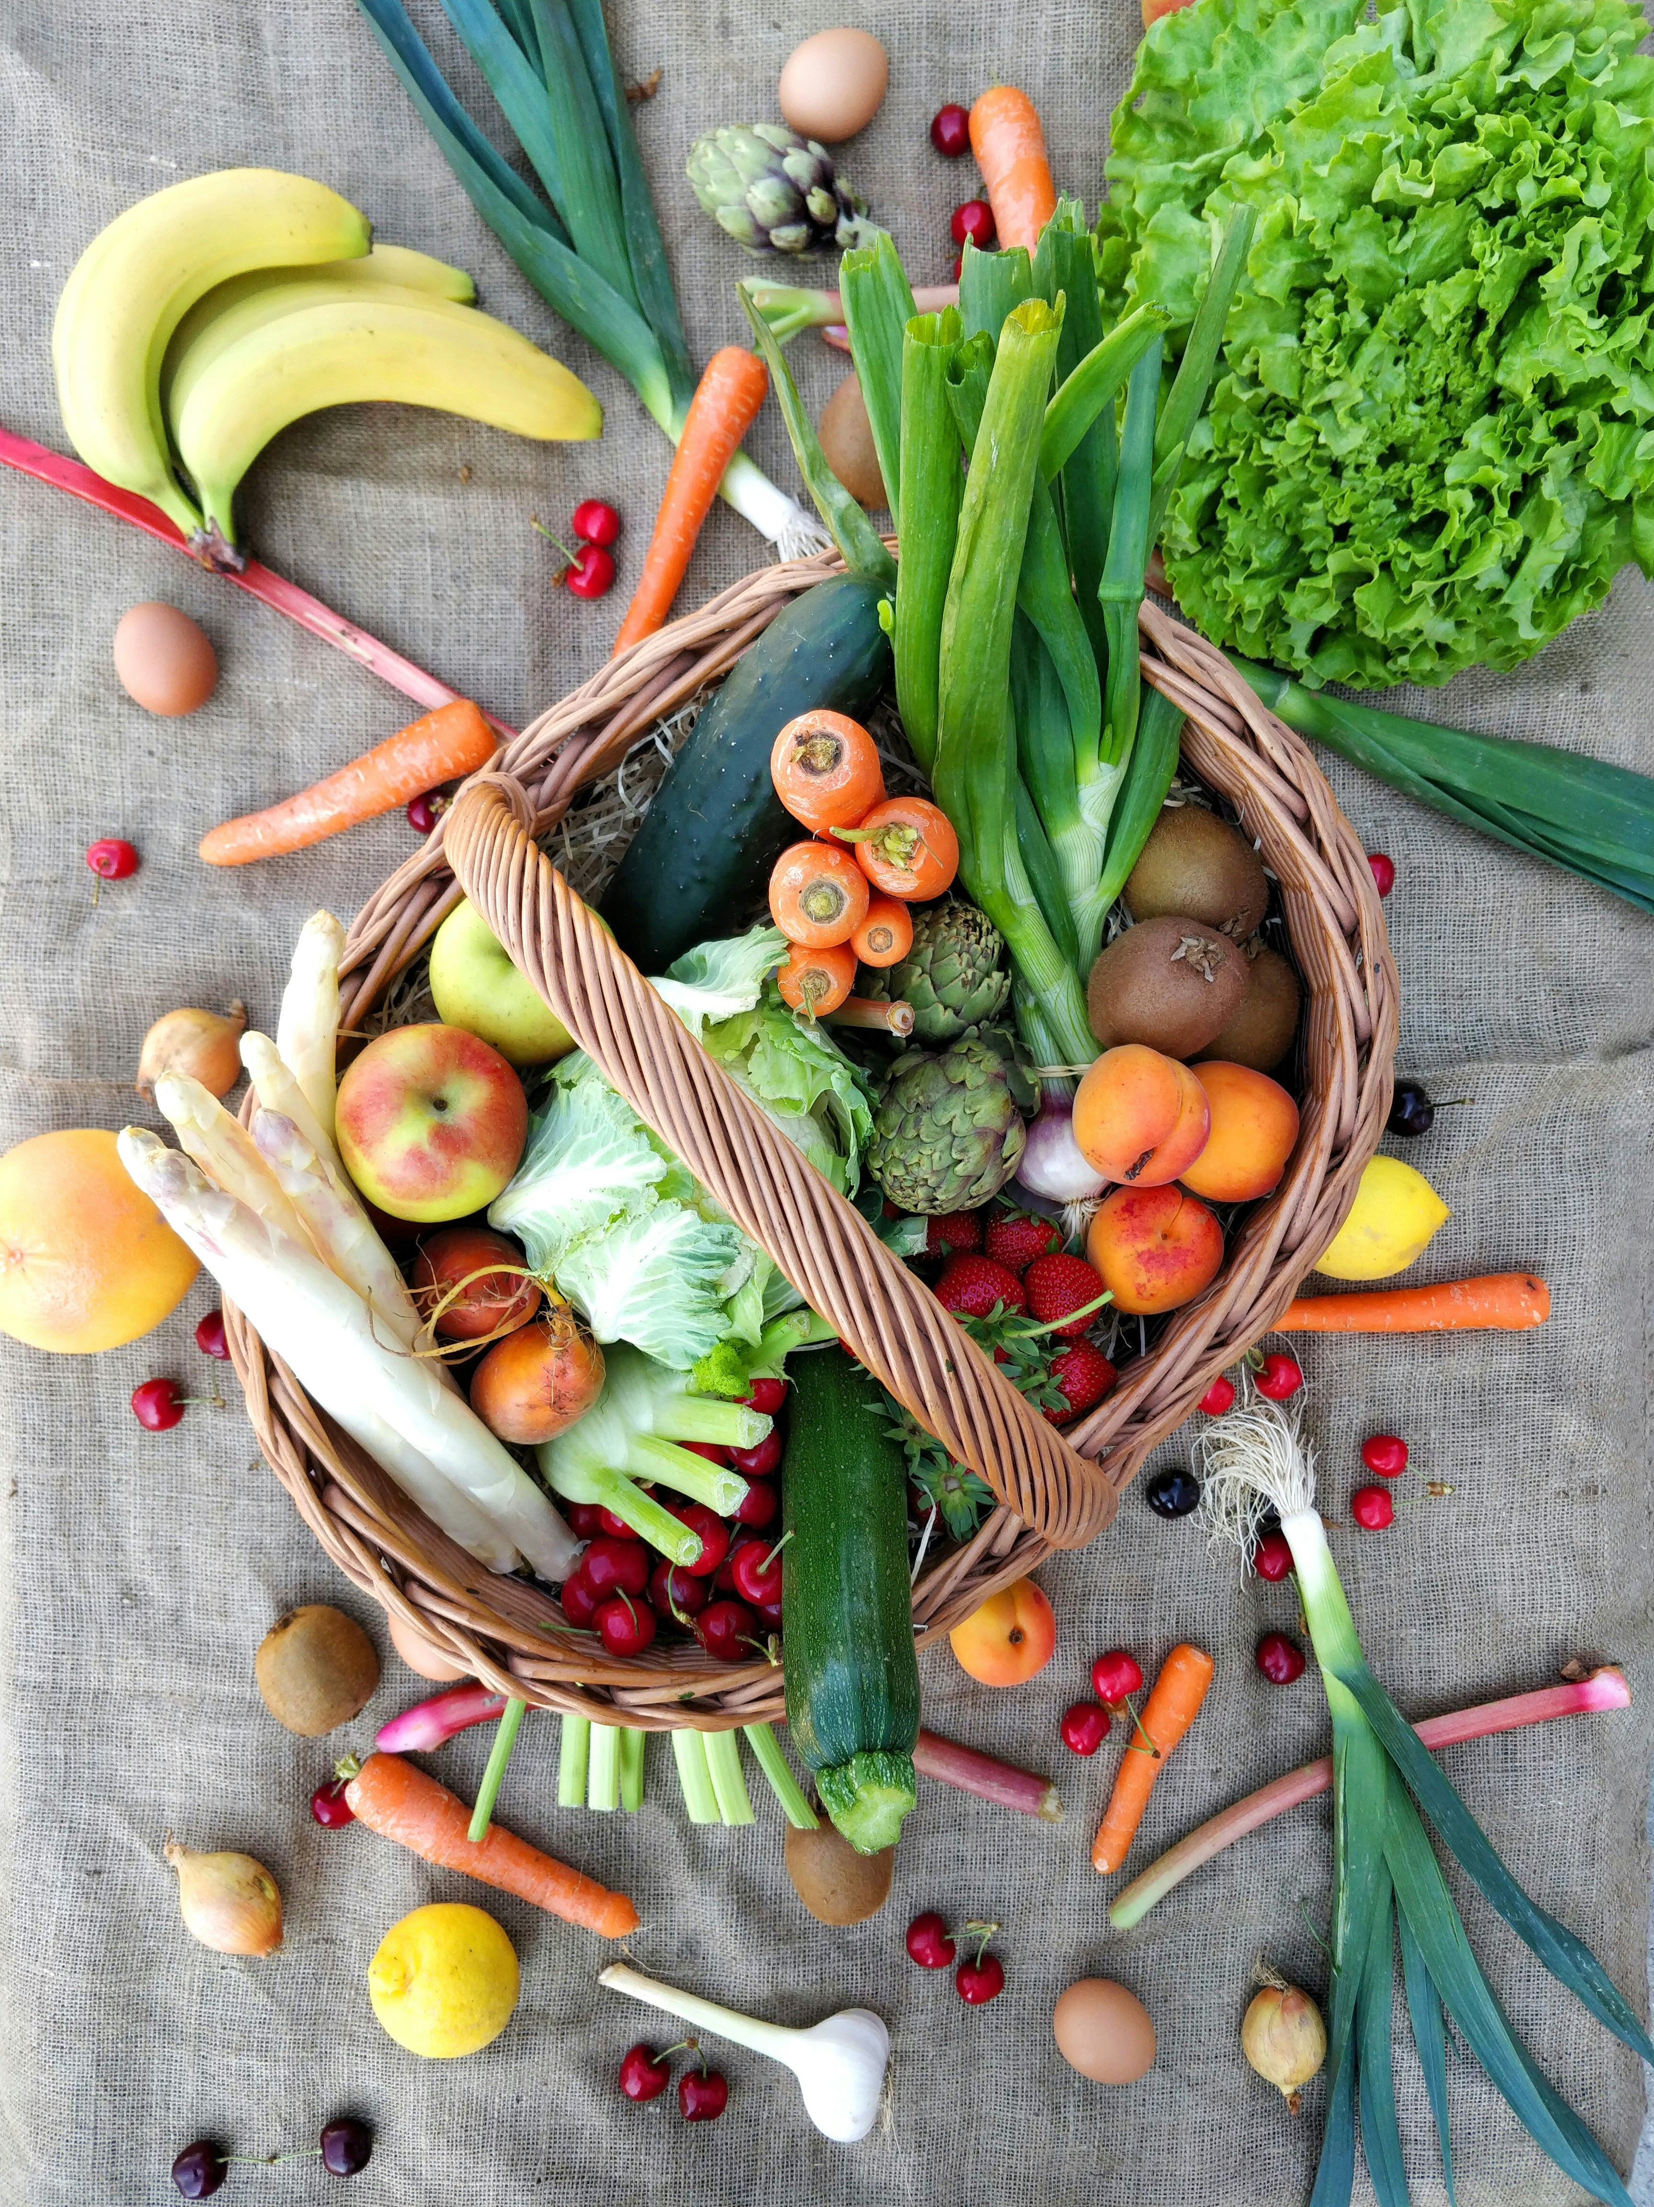
1. The Challenge
Minimum requirements:
Intact
Clean
Firm
Not forked, free of secondary roots
Not woody
Globally, 1/3 of all produced food is wasted.
In Switzerland, we generate 2.8 million tons of food waste annually.
The Root Cause
Size:
Minimum:
  10 mm / 8 g (early crop/small root)
  20 mm / 50 g (main crop/large root)
Maximum:
  40 mm / 150 g (early crop/small root)
  45 mm / 200 g (main crop/large root)
Supermarkets (Migros, Coop, etc.) enforce rigid, fixed-quantity contracts and strict cosmetic norms.
To guarantee they meet these quotas and visual standards, farmers are forced into systematic overproduction. The perfectly edible surplus is discarded.

Slide 3

2. Our Solution: Harvest Rescue
100%
A Direct-to-Consumer Subscription App
We are creating a subscription model ("Abo") that connects consumers directly with the producer, preventing agricultural surplus from being thrown away.
HARVEST UTILIZATION TARGET
Why it's innovative: Instead of a fixed shopping list, subscribers receive dynamic boxes based entirely on what is currently overproduced and in season. We bypass retail intermediaries entirely, securing farmer incomes and rescuing perfectly good food.

Slide 4









Its essential to free the farmers from the immense pressure their a facing regarding deliveries; they must enter into contracts with major buyers—primarily Migros and Coop in Switzerland—that bind them to rigid delivery volumes, regardless of the actual growing conditions.
3. How It Works
1. Smart Matching
2. Optimized Routes
3. Seasonal Recipes
An alternative to large supermarkets is the subscription-based vegetable box, which covers weekly needs for seasonal vegetables, fruit, and grains. The app allows farmers to trade varioud produce amongst themselves and consumers to access information.
To keep the carbon footprint minimal, the app calculates the absolute shortest delivery routes directly from the farm to the local consumers.
To ensure less waste at home, the app offers curated, seasonal recipes tailored exactly to the unexpected ingredients included in that week's box as well as their origin.

Slide 5
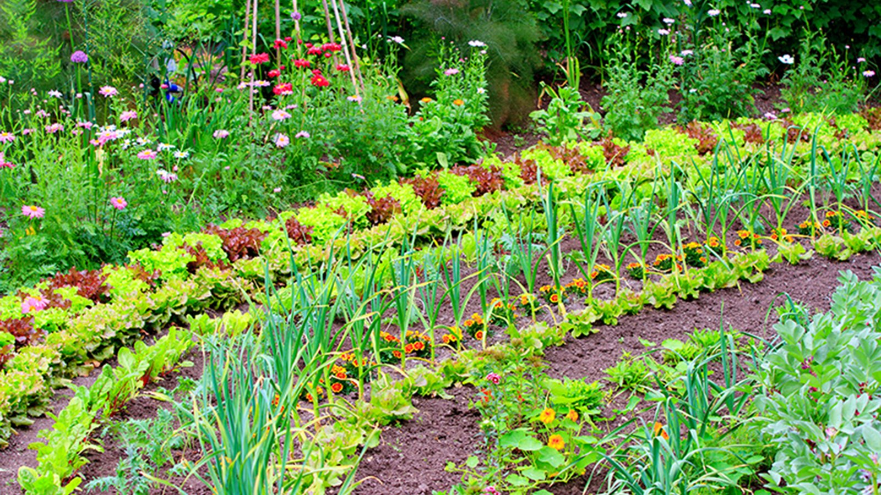



4. Sustainability Impact
Environmental & Social Benefits
Challenges & Trade-offs
Reduced Emissions: Bypassing central warehouses and distributing locally reduces CO2 emitted by transportation and storage.
Last-Mile Logistics: Delivering to individual homes can be emission-heavy if not densely routed (Mitigated by AI routing). For densely populated areas, specific drop-off points might be an option.
Reduce Waste: The perfectly edible produce are actually consumed, not just repurposed as expensive fertilizer.
Packaging: Requires reusable crate systems to avoid replacing food waste with i.e. cardboard waste.
Economic Fairness and Resource Efficiency: Farmers are compensated for their full labor, not just the "perfect" yields.
Consumer Flexibility: Requires a shift in mindset—cooking what is available, not what is planned.
Health & Nutrition: Eating fresh, seasonal vegetables and fruits comes with a variety of health benefits as well as great taste.

Slide 6
5. Implementation Plan
Phase 2: Regional Pilot
Bottleneck
Overcoming the high cost of decentralized last-mile delivery and changing rigid consumer shopping habits.
Launch beta subscription to 500 households. Test routing algorithms and recipe engagement.
Phase 1: Foundation
Phase 3: Scaling
Develop MVP App. Partner with 5-10 early-adopter farmers in a specific region.
Expand across Switzerland. Introduce reusable logistic crates and B2B subscriptions.

Slide 7
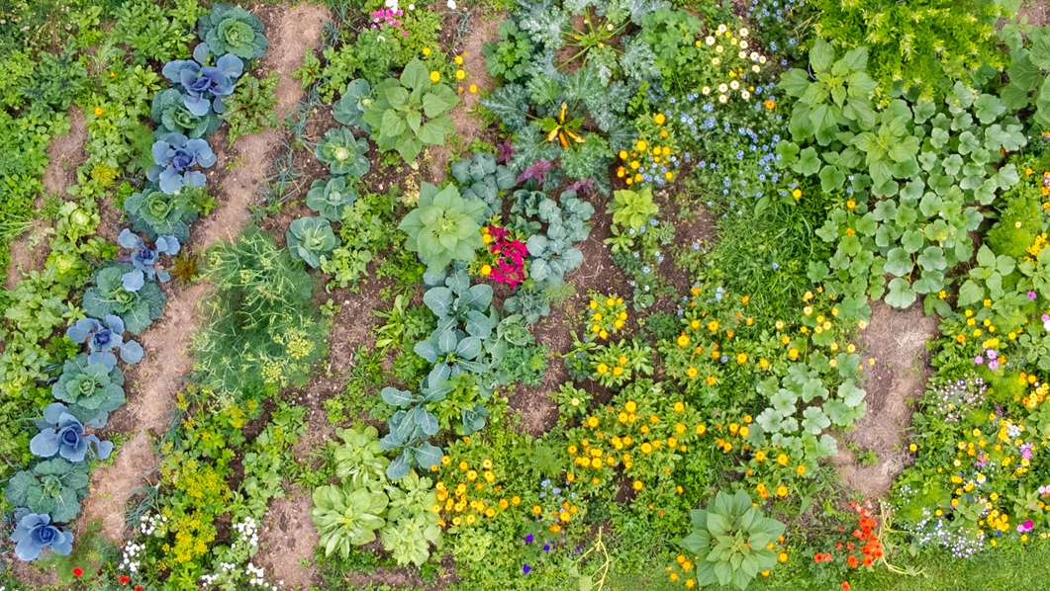
"Stop discarding perfection. Start subscribing to sustainability."
Free the Carrots

Slide 8
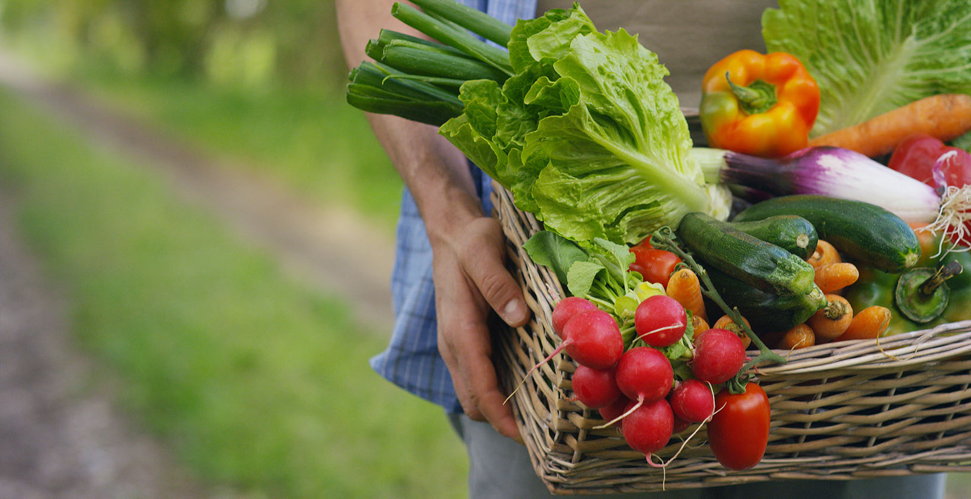
Thank you
for your
Attention.
…and let's have
a discussion!
☺

